Slide 1

Sales Data Analysis
Mohamed Yasir
Notes:
Photo by Carlos Muza on Unsplash

Slide 2
Exploratory Data Analysis

Slide 3

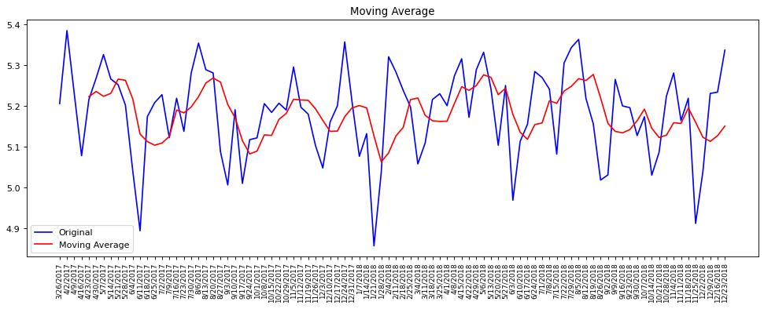
Sales Moving Average
Fig 1. Moving Average
Fig. 1 shows there is a stationary trend in sales over time.
At the end of 12/23/2018 there is a strong uptrend above the moving average but still unreliable due to outliers
Notes:
Photo by fauxels from Pexels

Slide 4

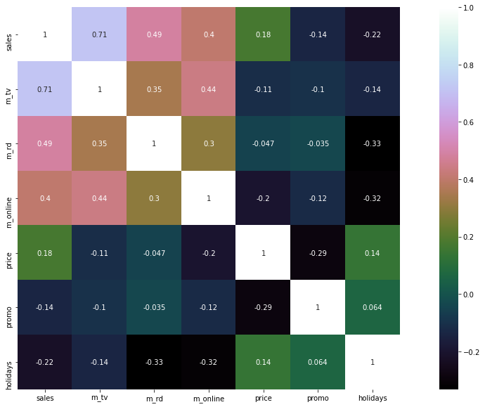
Pearson Correlation Coefficient matrix
Promo and Sales
Promo durations has very weak relationship with sales
TV and Sales
TV channel has the best overall relationship with sales in positively driving up.
Fig 2. Correlation Coefficient Matrix

Slide 5

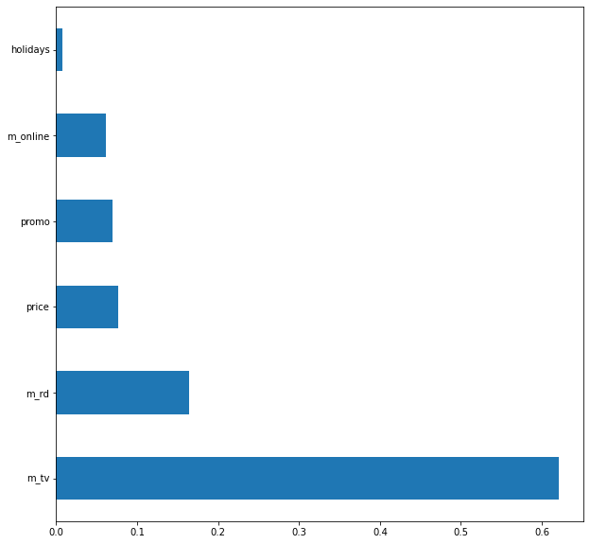
Feature Importance in Predicting Sales
TV
Shows major participation in sales prediction
68%
Fig 3. Feature Importance Comparison
68%
Online
Surprisingly, online scored less than other marketing channels
3.3%
3.3%
Holidays
Feature playing very little role in the regression
<1%
<1%
Notes:
Photo by fauxels from Pexels

Slide 6
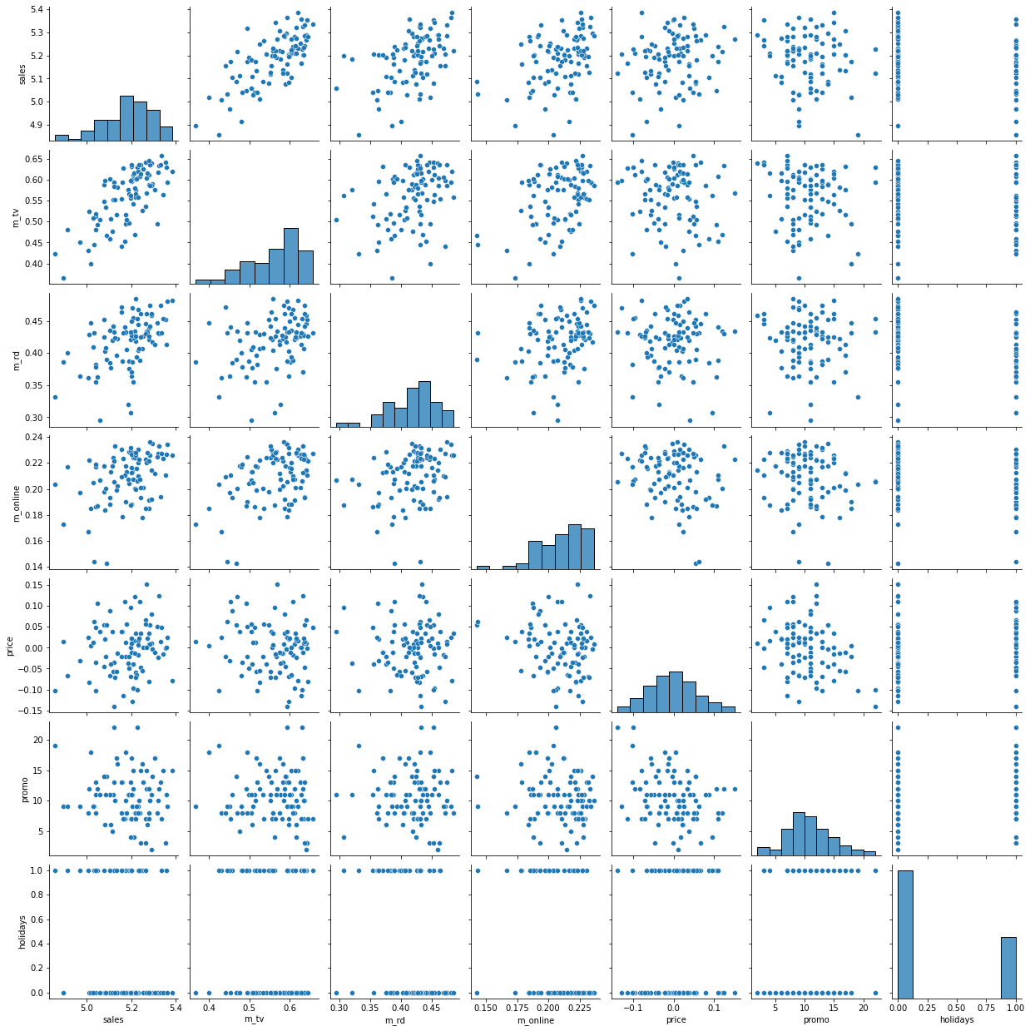
Graph comparison clearly shows the important role of the marketing channels in changing sales numbers
Online marketing has a weak relationship with sales compared to other marketing media
Fig 4. Pair plot
Notes:
Photo by fauxels from Pexels

Slide 7
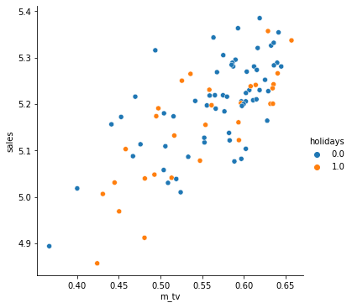
Fig. 5 shows the higher number of sales occurred in the weeks that didn’t have holiday
Higher tv channel spending resulted in higher sales
Fig 5. TV vs Channel Scatter plot

Slide 8
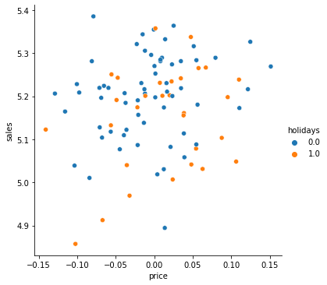
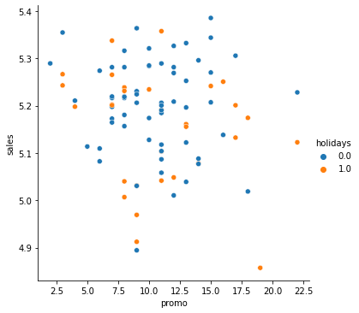
Here, price and promo duration have very less contribution in driving the sales.
Sales distributed all over the price changes. Fig. shows decrease in price recorded least sales numbers
Fig 6. Price vs Sales
Fig 7. Promo durations vs Sales

Slide 9
Comparing Performances of Some of Machine Learning Models using R² and RMSE

Slide 10
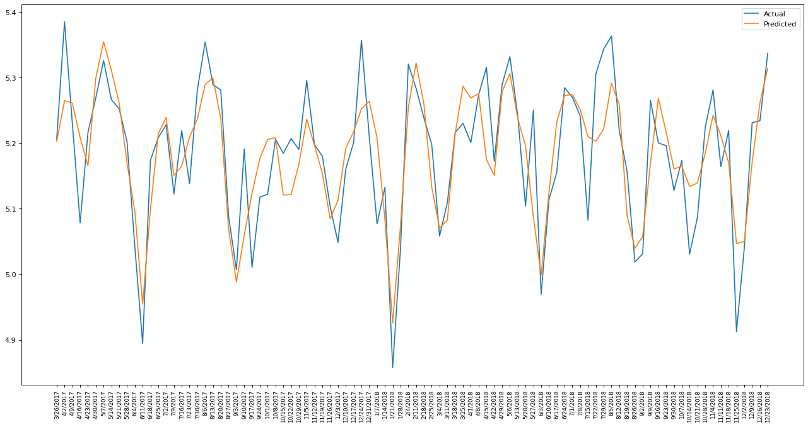
Ordinary Linear Regression(OLS)
OLS performed comparatively well in predicting training data with few misses
R² = 0.6578
RMSE = 0.0632
Fig 10. Actual vs Predicted using multiple OLS on training data
Notes:
0.6578

Slide 11
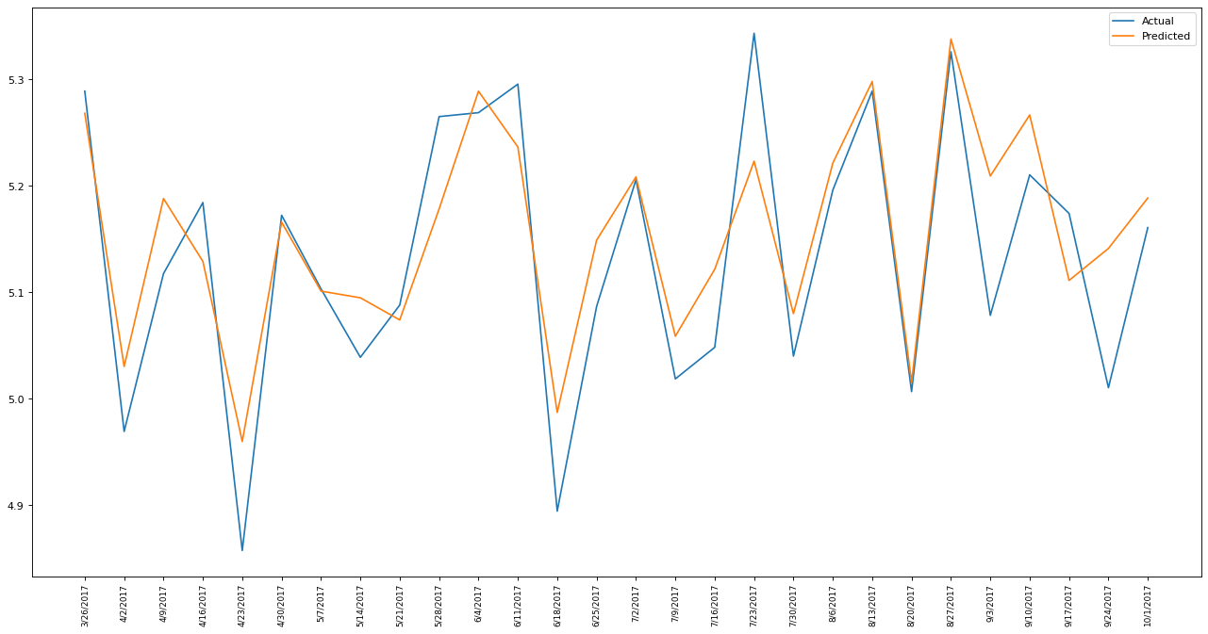
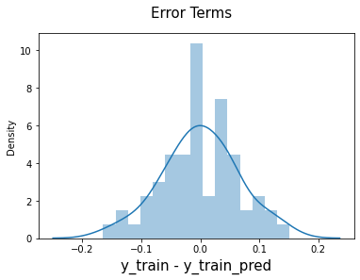
Multiple Regression
Graph showcases the prediction of sales without promo duration feature.
R² = 0.743
RMSE = 0.0643
Fig 8. Actual vs Predicted plot from Simple Linear Regression
Fig 9. Cost function optimization
Notes:
0.0643

Slide 12
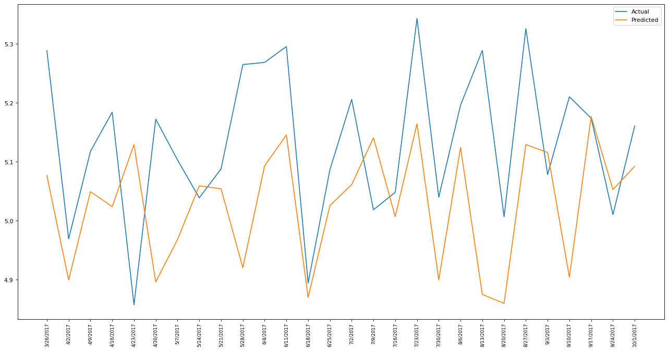
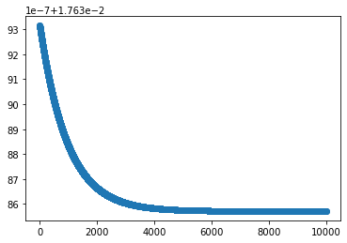
Multiple Regression with Gradient Descent Optimization
Trained with 70% of the data , tested using remaining 30% test data
R² = 0.2044
RMSE = 0.1746
Fig 11. Actual vs Predicted sales - Multiple regression
Fig 12. Cost function optimization

Slide 13
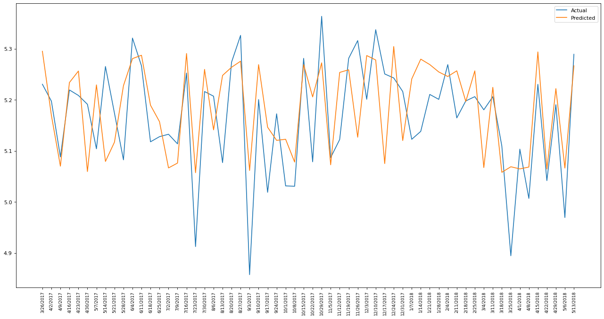
Random Forest Regressor
R² = 0.2889
RMSE = 0.0914
Fig 13. Actual vs Predicted sales - random forest regressor
Notes:
0.0914

Slide 14
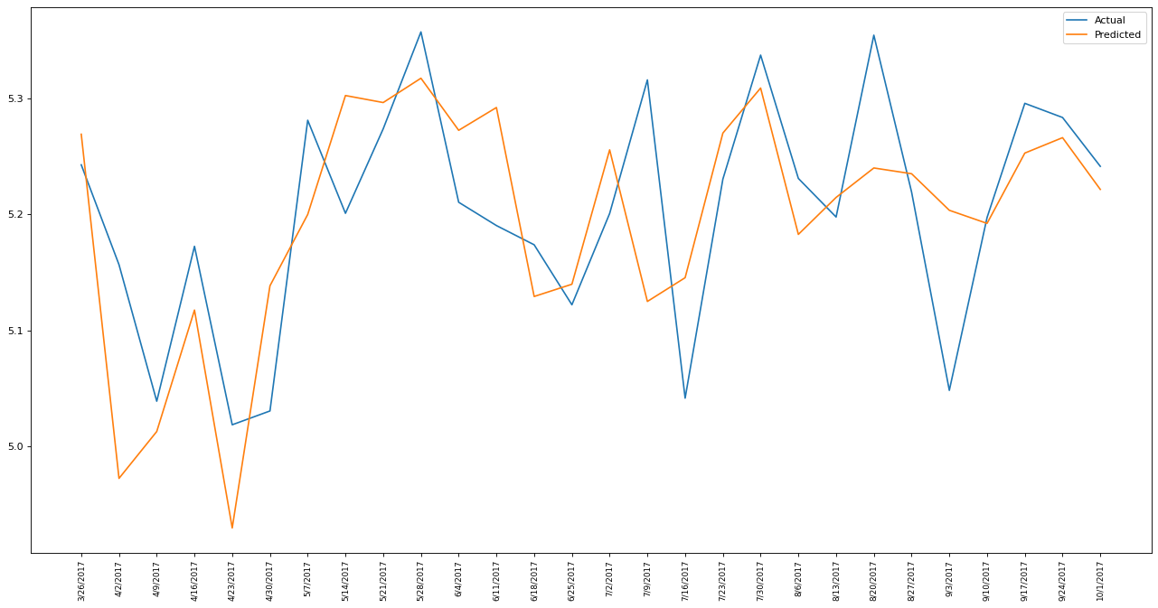
Gradient Boost Regression
R² = 0.289
RMSE = 0.0914
Fig 14. Actual vs Predicted sales gradient boost regression
Notes:
0.0914

Slide 15
Thank You
Submitted by
Mohamed Yasir
Contact: LinkedIn
Ph: 4192695724

